Slide 1
Artificial Neural Network-Based Robotic Control
Master’s Thesis
Justin Ng
June 8, 2018
Committee Chair Committee Member Committee Member | Andrew Danowitz, Ph.D. Xiao-Hua Yu, Ph.D. Fred W. DePiero, Ph.D.

Slide 2
Outline
Outline
Teaser
Introduction/Motivation
Background
Solution
Implementation
Results
Future work and conclusions

Slide 3
Outline
Outline
Teaser
Introduction/Motivation
Background
Solution
Implementation
Results
Future work and conclusions

Slide 4
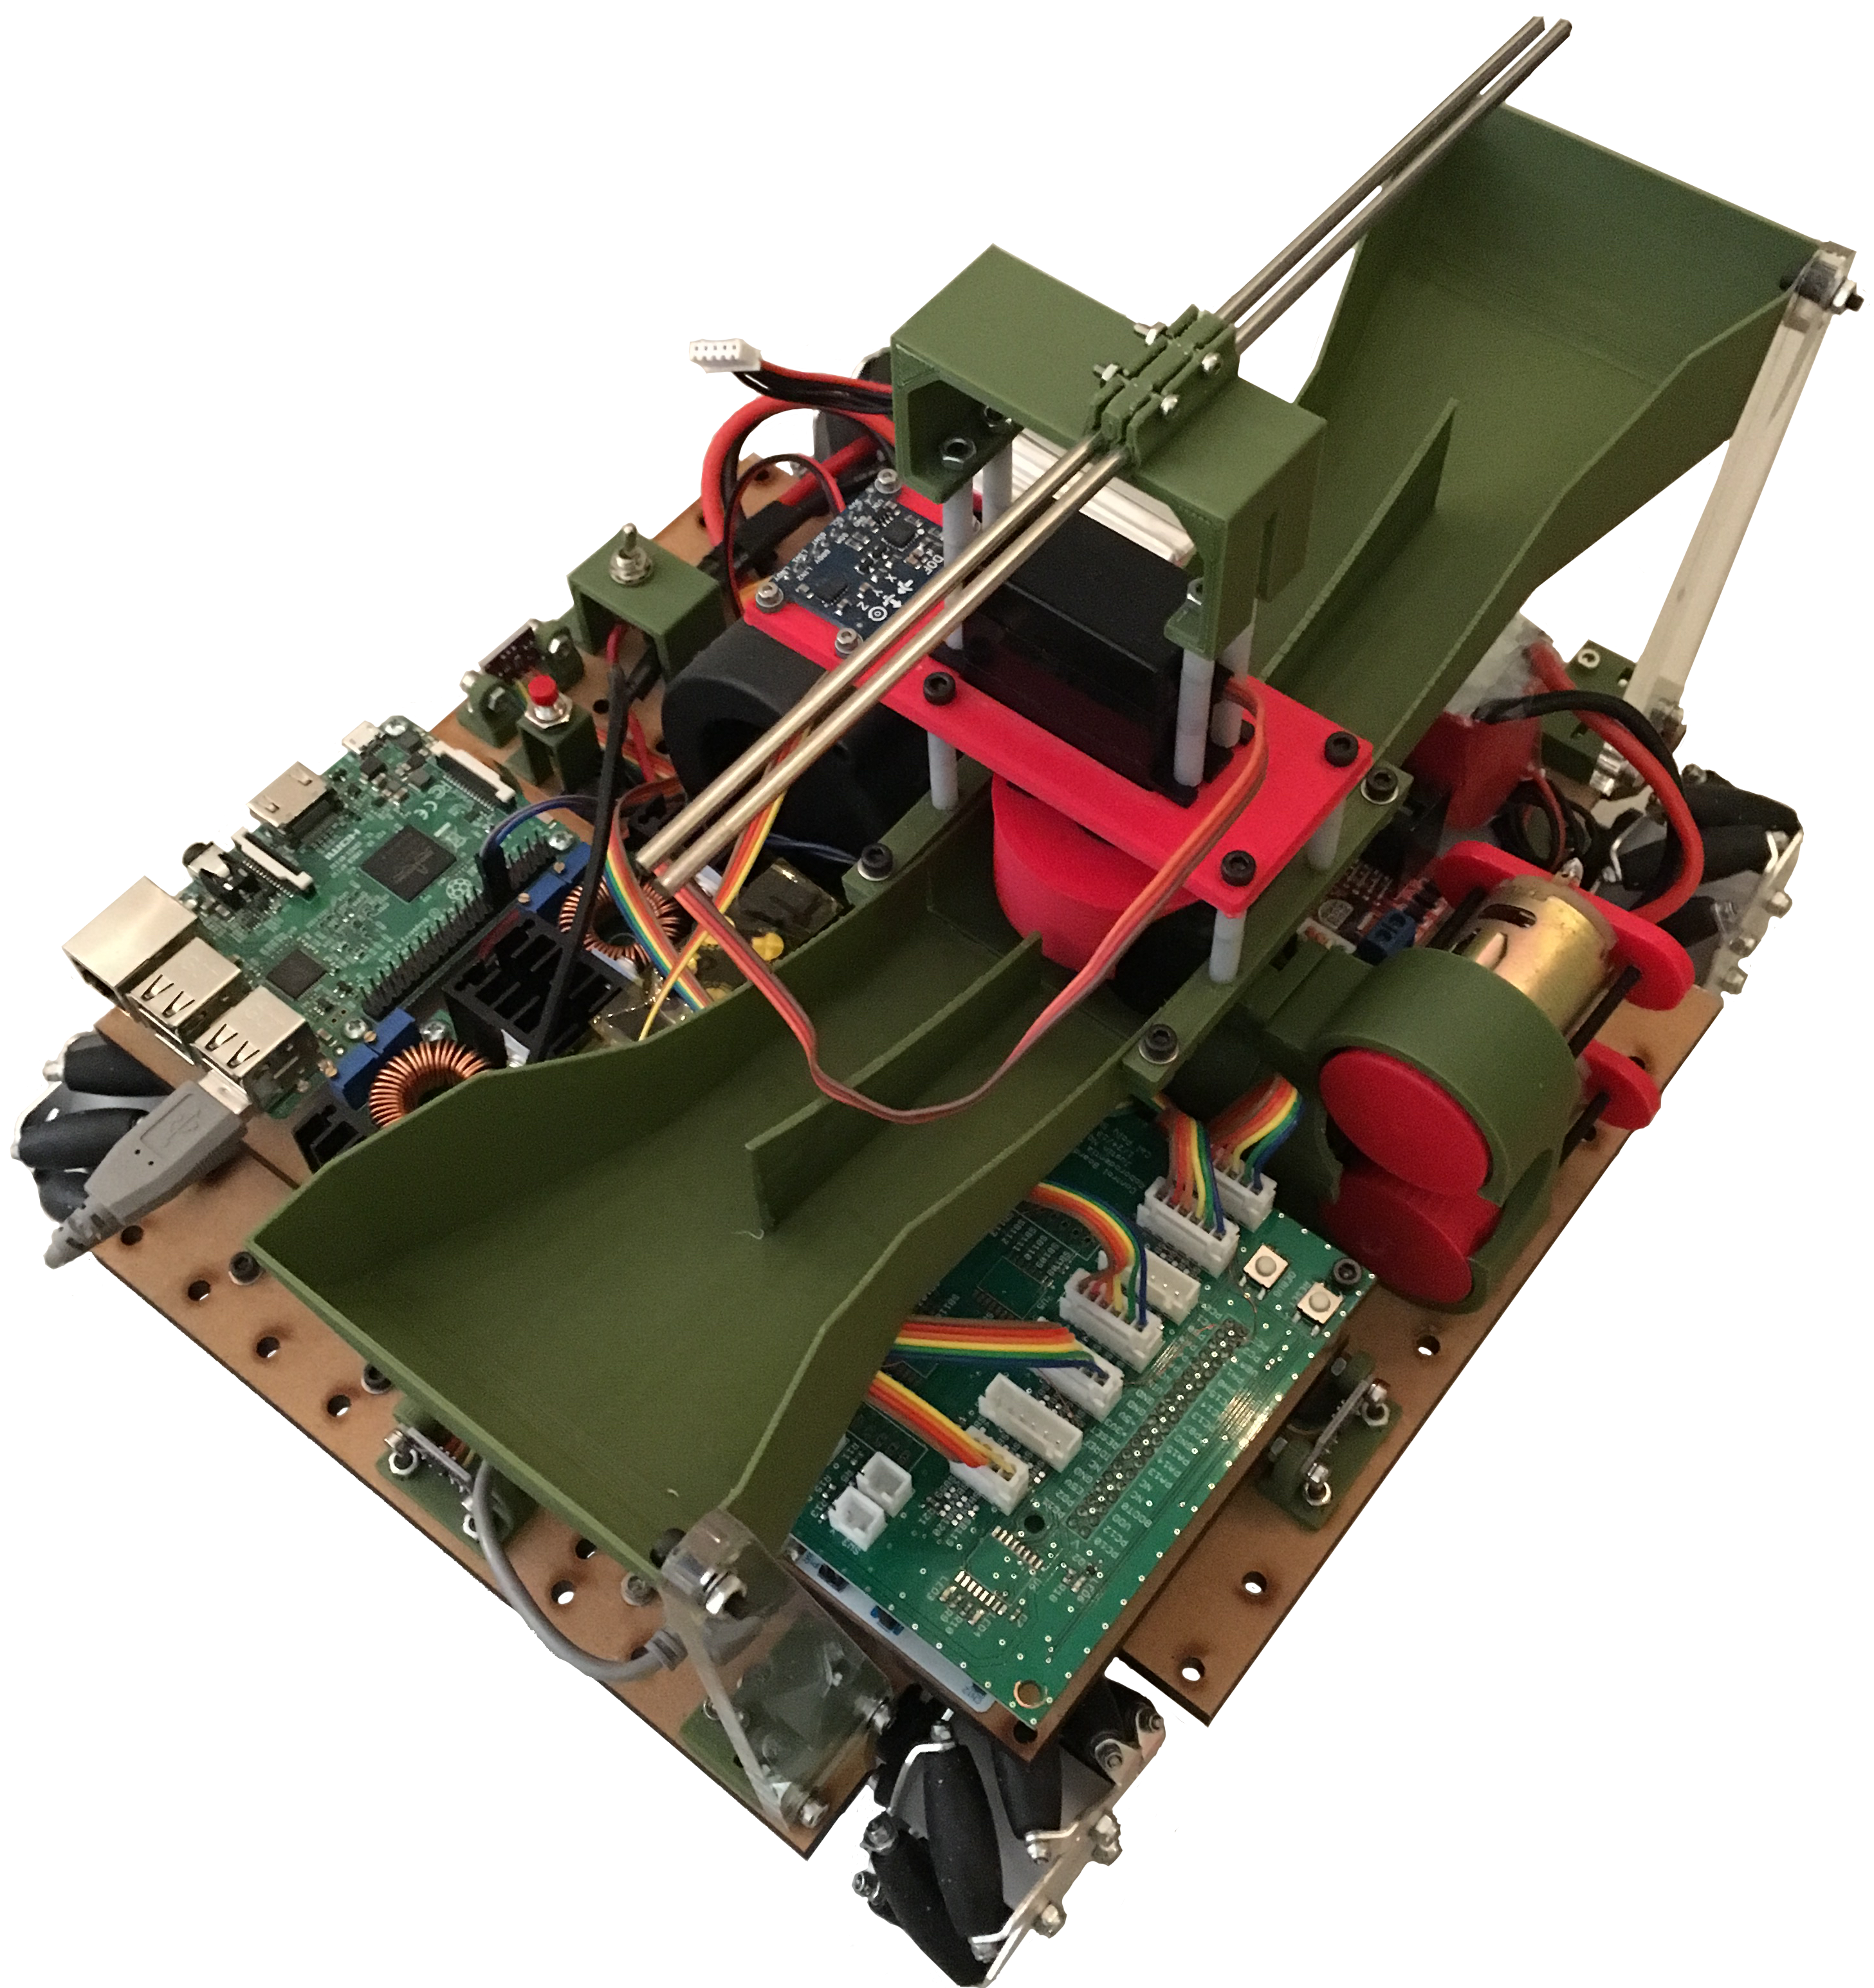
Teaser
Reinforcement learning applied to continuously-controlled robotics.
Controller sets robot’s position and orientation in the environment.

Slide 5
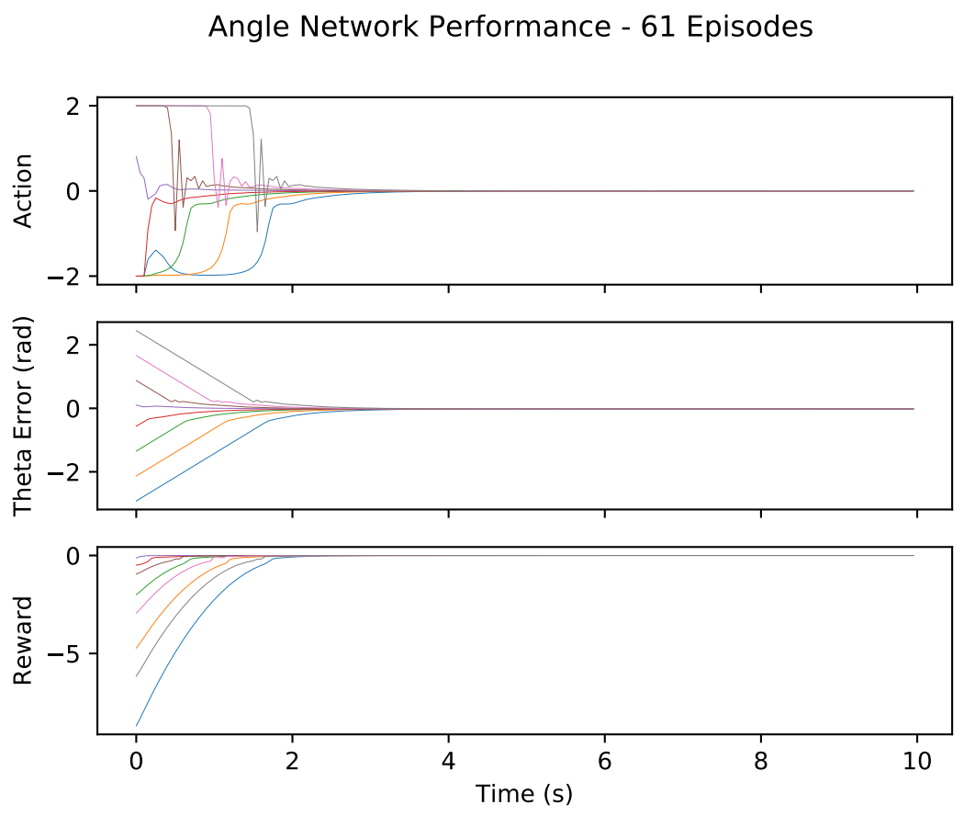
Teaser
Uses the deep deterministic policy gradients method developed by DeepMind.
Model-free, actor-critic algorithm implemented with artificial neural networks.

Slide 6
Outline
Outline
Teaser
Introduction/Motivation
Background
Solution
Implementation
Results
Future work and conclusions

Slide 7

Cal Poly Roborodentia
Annual intramural robotics competition.
Fully autonomous robots.
Different game every year.
Source: http://roborodentia.calpoly.edu/
Notes:
Introduce Roborodentia.

Slide 8
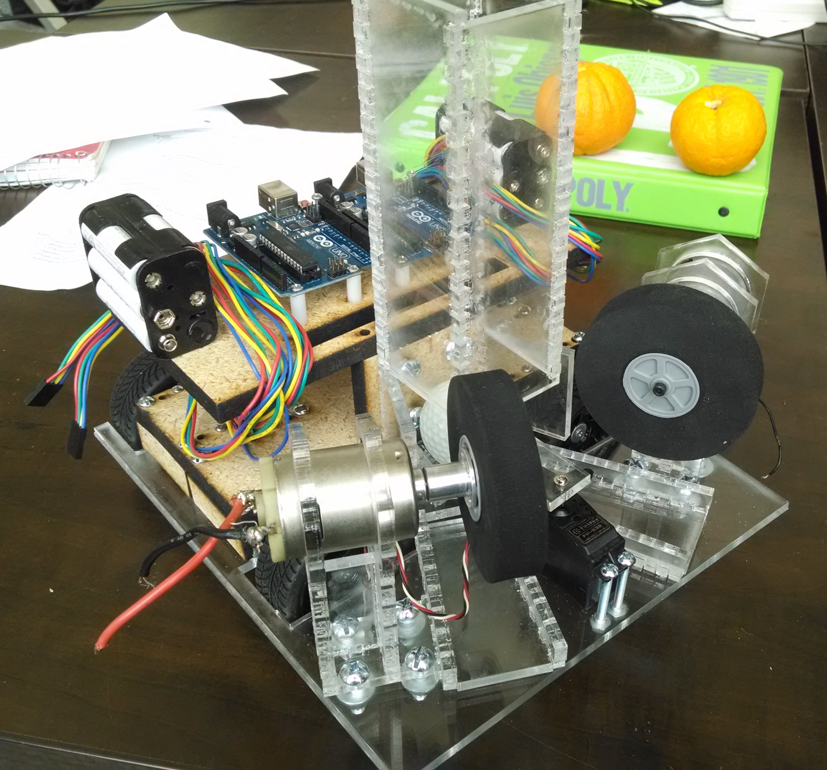
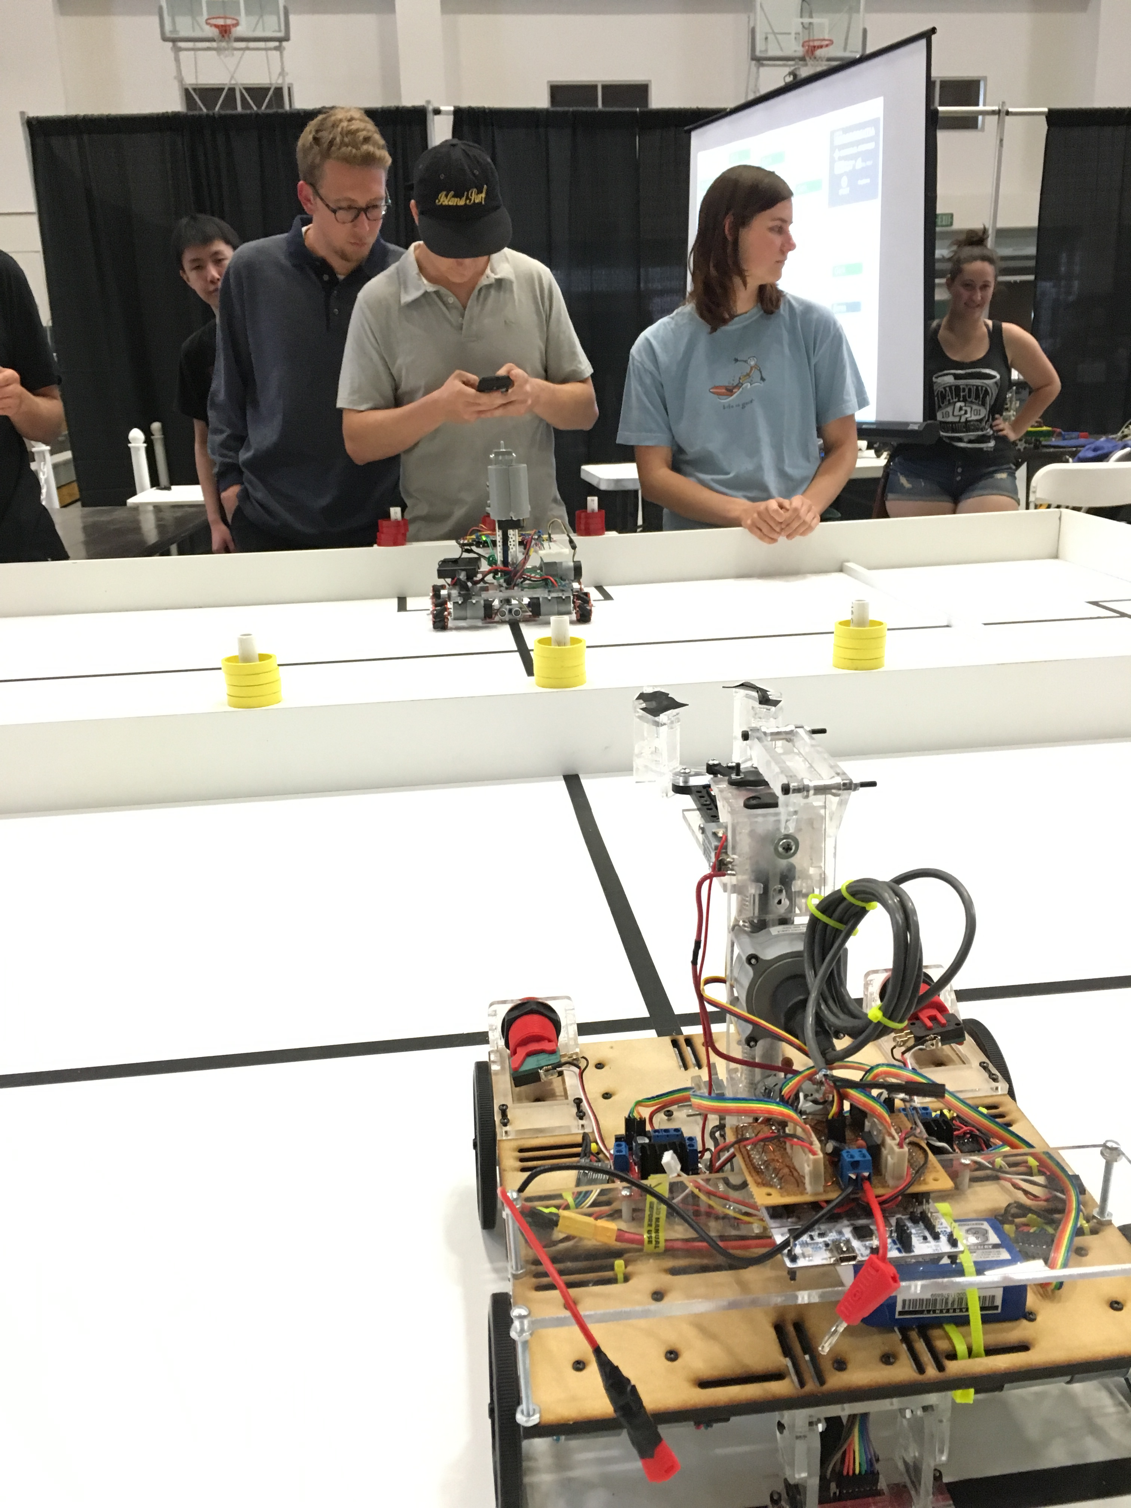
Previous Roborodentia Entries

Slide 9
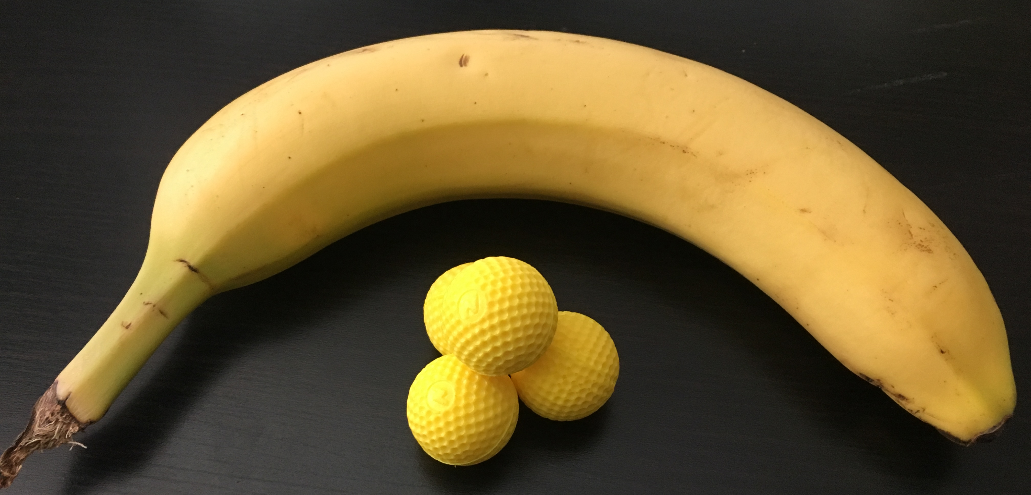
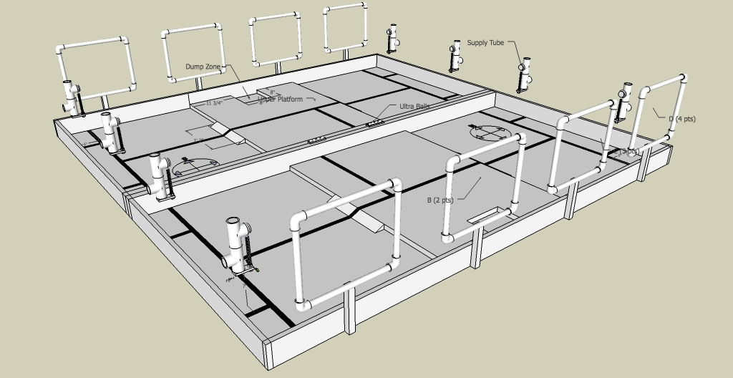
2018 Cal Poly Roborodentia
Robots obtain Nerf Rival balls from supply tubes.
Shoot balls into nets to score points.
Source: http://roborodentia.calpoly.edu/
Notes:
Introduce Roborodentia.

Slide 10
2018 Entry
Built from scratch.
Contains numerous custom parts and electronics.
394 individual parts.
Notes:
3d printed parts.

Slide 11
Problem Statement
Use machine learning to control robot’s position and orientation in the field with continuous state and action spaces.
Receive state information from sensors and output four motor voltages to drive robot wheels.

Slide 12
Outline
Outline
Teaser
Introduction/Motivation
Background
Solution
Implementation
Results
Future work and conclusions

Slide 13
Reinforcement Learning (RL)
Subset of machine learning.
Solves control and action selection problems.
“In-between” supervised and unsupervised learning.

Slide 14
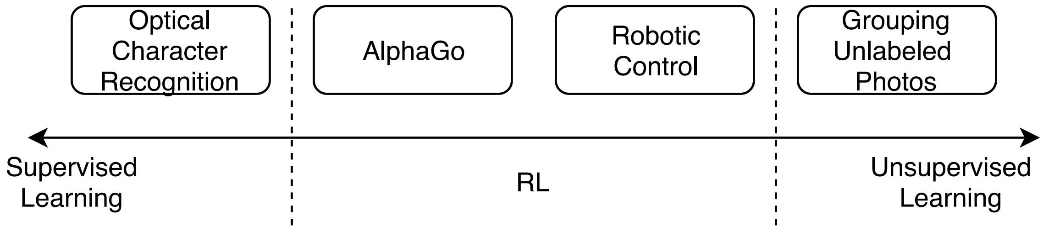
Other Kinds of Learning
Supervised learning: perform classification.
Unsupervised learning: data clustering, find underlying patterns.

Slide 15
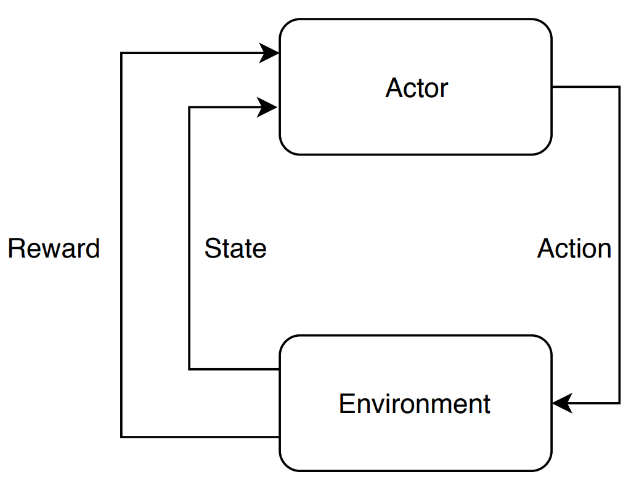
Reinforcement Learning Elements
Environment
Actor/agent
Reward/return (R, r)
Policy (π)
Value function (V, Q)
Sometimes a model
Notes:
Environment The various states and associated rewards through which the actor navigates.
Actor/Agent Chooses actions based on a policy.
Reward/return (r) A number emitted by the environment denoting ”goodness” of the state
Policy (π) The strategy by which the actor chooses its actions, e.g. random, exploratory, greedy.
Value (V) The expected long-term discounted reward of a state.
Model allowing prediction of the next state from the current state and action

Slide 16
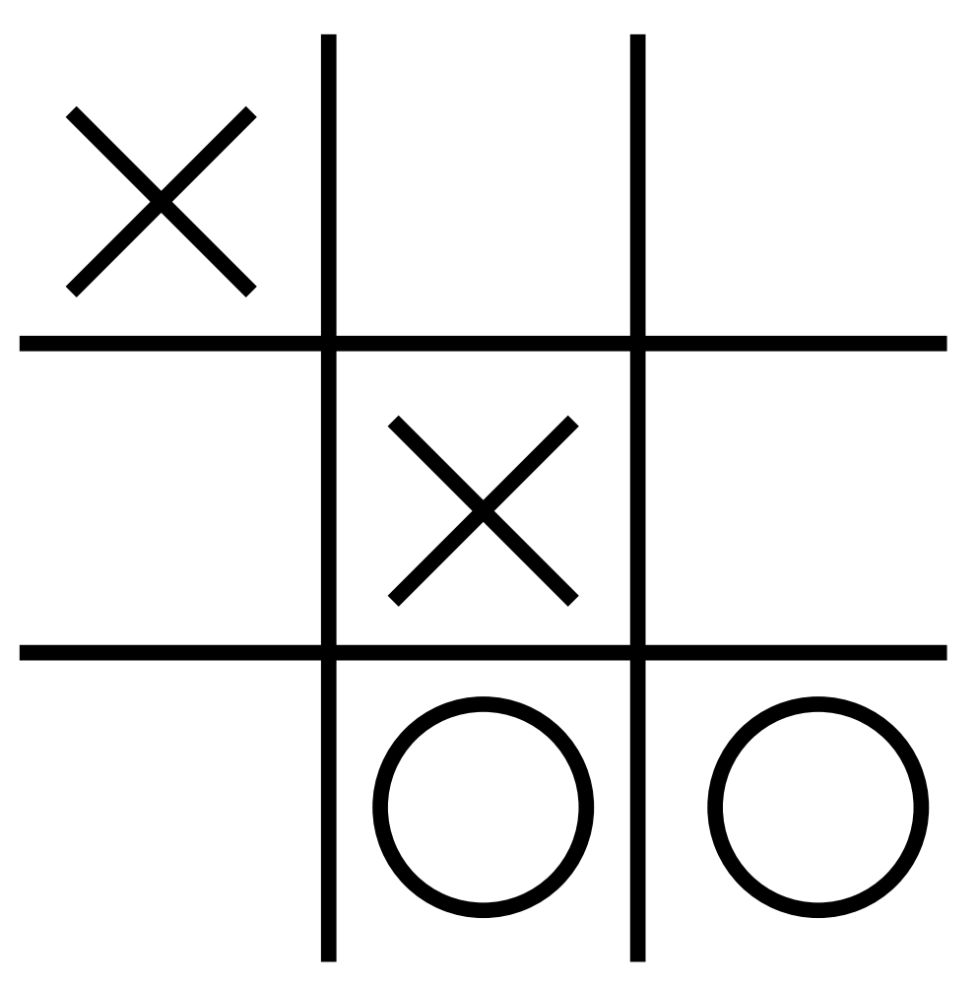
Reinforcement Learning Elements – Tic Tac Toe Example
Environment
Actor
Action (a_{k})
Reward (r_{k})
State (s_{k})
Transition [s_{k}, a_{k}, r_{k}, s_{k+1}]

Slide 17
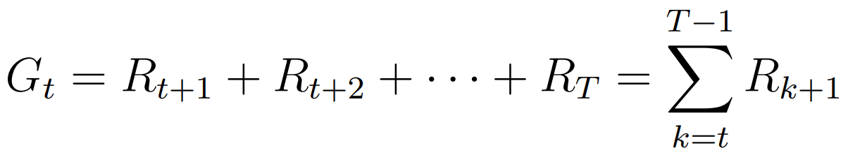
Long-term Reward G_{t}
Calculated as sum of all future rewards.
Usable in RL problems with a definitive end.
Actor’s goal to maximize G_{t}.

Slide 18
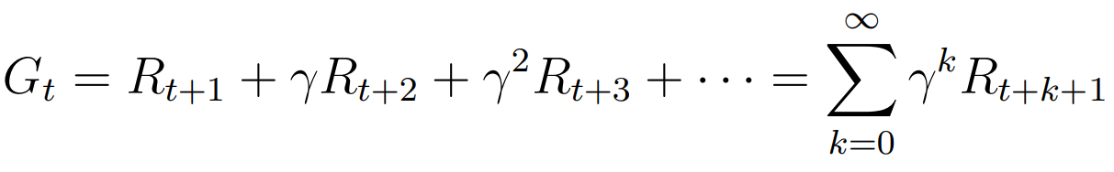
Long-term Discounted Reward G_{t}
Calculated as sum of all future rewards weighted by a discount factor γ.
Allows G_{t} to converge for environments with no maximum time step.
Sets algorithm’s “outlook” from myopic to far-sighted.
Notes:
Gamma ranges from 0 to 1
1 is

Slide 19
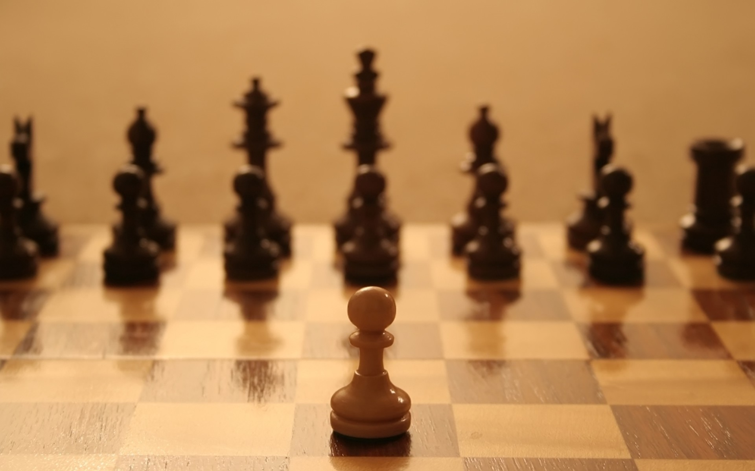
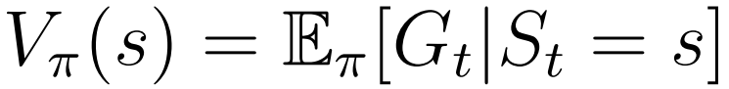
Value Functions
Indicates the long-term reward expected from a state under a certain policy π.
Even if a state only has a small immediate reward, it may possess high value since it leads to high reward states.
Source: https://arcdigital.media/the-trans-pacific-partnership-
a-pawn-sacrifice-in-a-global-game-22e62cdf775
Notes:
Imagine a game of chess. Sacrificing a piece may seem like a negative action but may open other opportunities.

Slide 20
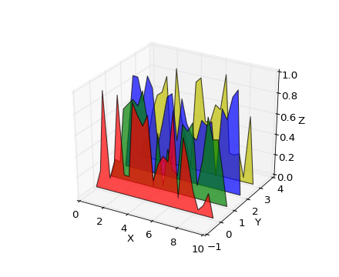
Q-Functions
Expected long-term reward as a function of the state and action under a certain policy π.
Represents the quality of an action in a particular state.
Source: https://matplotlib.org/1.3.0/mpl_examples
/mplot3d/polys3d_demo.png
Notes:
For the game of tic tac toe, there are values for each of 19,683 states.

Slide 21
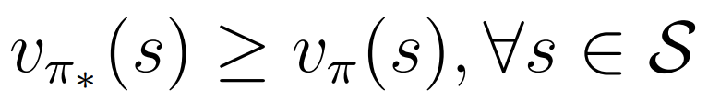
Policies
Optimal (π∗): produces greater or equal value for every possible state than any other policy (π).
Greedy: take action with highest value/Q-value.
Random: pick a random action.
ε-greedy: pick greedy action with probability 1- ε and random action with probability ε.

Slide 22
On-Policy vs. Off-Policy
On-policy algorithms: learn the policy followed by the actor.
Off-policy algorithms: learn a policy different from the one followed by the actor.
Exploration vs. Exploitation
Notes:
On-policy: typically less efficient.
Off-policy: more efficient at exploring but less likely to converge.

Slide 23
RL Algorithms
Q-Learning
State-Action-Reward-State-Action (SARSA)
Deep Q-Network (DQN)
Stochastic Policy Gradients (PG)
Deterministic Policy Gradients (DPG)
Deep Deterministic Policy Gradients (DDPG)

Slide 24
Q-Learning
Model-free, off-policy algorithm that estimates the Q-function of the environment.
Q-function represents the ”quality” of every possible action in every possible state.
Notes:
For example, imagine a game of tic-tac-toe as shown in Figure 6.2. Each of the nine spaces can take one of three values (blank, X, or O) so the game has 39 = 19, 683 possible states (although some states are not achievable as the game would end once a player gets three in a row). Given a particular state, the Q-function returns the quality, i.e. predicted goodness, of each possible action the player could take. Therefore, the optimal action to take is simply the one with the highest Q-value.

Slide 25
Tabular Q Methods
 |  | Action
 |  | Put X in top left | Put X in top middle
State |  | -5.8 | -4.3
 |  | 3.3 | -5.2
Tabular Q-learning methods use a 2-D matrix to represent the Q-function.
Iteratively calculated using the Bellman equation.
Notes:
Explain max_a’, s’, a’

Slide 26
Tabular Q Iterative Update
Iteratively calculated using the Bellman equation.
Learning rate α improves convergence.

Slide 27
RL Algorithms
Q-Learning
State-Action-Reward-State-Action (SARSA)
Deep Q-Network (DQN)
Stochastic Policy Gradients (PG)
Deterministic Policy Gradients (DPG)
Deep Deterministic Policy Gradients (DDPG)

Slide 28
State-Action-Reward-State-Action (SARSA)
Model-free, on-policy algorithm similar to Q-learning.
Updates Q based on next state and action instead of greedy action:
Compare to Q-learning update:

Slide 29
Q-Learning and SARSA Issues
Not practical for large state or action spaces.
(# of Q table elements) = (# of states) x (# of actions)
Not practical for continuous state or action spaces.
Cannot generalize learnings. Must explore all (state, action) combinations. Expensive!

Slide 30
RL Algorithms
Q-Learning
State-Action-Reward-State-Action (SARSA)
Deep Q-Network (DQN)
Stochastic Policy Gradients (PG)
Deterministic Policy Gradients (DPG)
Deep Deterministic Policy Gradients (DDPG)

Slide 31
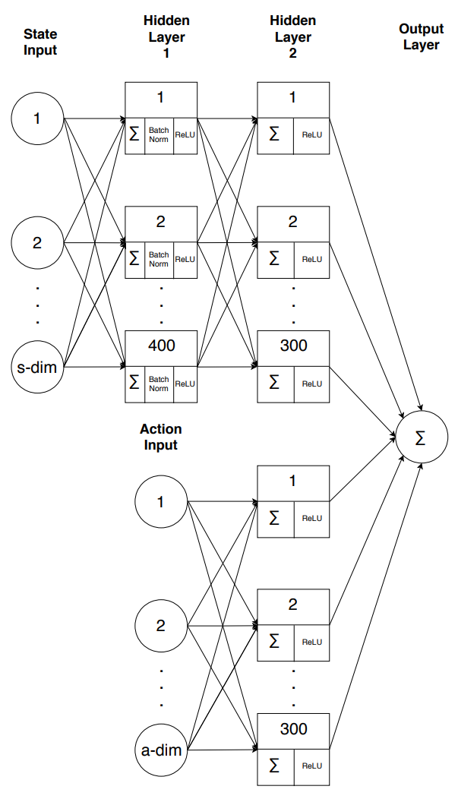
Deep Q-Network (DQN)
Model-free, off-policy method published by Mnih et al. in “Human-level control through deep reinforcement learning”.
Can determine Q for continuous state/action spaces.
Replace the Q table with artificial neural network (ANN) to allow generalization.

Slide 32
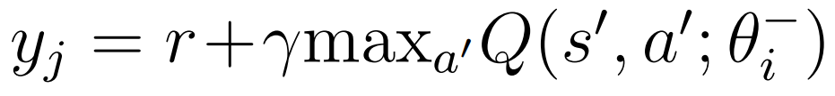
DQN ANN
Inputs: state and action.
Outputs: Q-value.
Target Q-value based on Bellman Equation:
Loss function:
Notes:
Explain theta^-

Slide 33
Two Critical DQN Learnings
Experience replay buffer
Records transitions.
Randomly sampled mini-batches remove time correlation.
Experience reuse.
Target network
Identical but separate Q-network.
Time delay between Q-network weight updates and policy change reduces policy instability.
Notes:
For example, using a 64 transition mini-batch, the network randomly samples 64 transitions from the experience replay buffer and trains the network Q with 64 iterations as in 6.7. After, the target network Qˆ clones the weights θi from Q and the process repeats.
Policy still uses discrete actions.

Slide 34
RL Algorithms
Q-Learning
State-Action-Reward-State-Action (SARSA)
Deep Q-Network (DQN)
Stochastic Policy Gradients (PG)
Deterministic Policy Gradients (DPG)
Deep Deterministic Policy Gradients (DDPG)

Slide 35
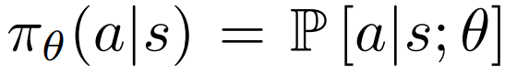
Stochastic Policy Gradient Method (PG)
Model-free, on-policy algorithm.
Find optimal policy directly without value or Q-function.
Policy produces continuous actions!
Policy implemented with a parametric probability distribution:
Notes:
Used by AlphaGo to defeat Fan Hui (2015) and Lee Sedol (2016).

Slide 36
Stochastic PG Premise
Get the current state.
Stochastically choose an action from distribution P[a|s; θ].
Record the reward.
If reward is “good”, change θ to make the action more likely.
Iterate many times so actor only takes “good” actions.

Slide 37
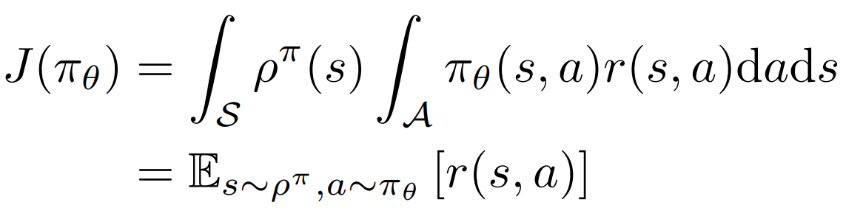
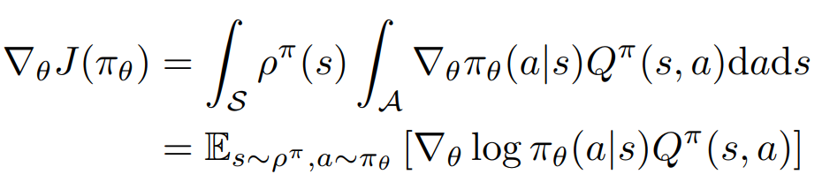
Policy Gradient as Derived by Sutton et al.
Objective function:
Policy gradient:
Source: R. Sutton, D. McAllester, S. Singh, and Y. Mansour. Policy Gradient Methods for Reinforcement Learning with Function Approximation, pages 1057–1063. 1999.
Notes:
Gradient with respect to each theta parameter tells you which way to push the parameter.

Slide 38
RL Algorithms
Q-Learning
State-Action-Reward-State-Action (SARSA)
Deep Q-Network (DQN)
Stochastic Policy Gradients (PG)
Deterministic Policy Gradients (DPG)
Deep Deterministic Policy Gradients (DDPG)

Slide 39
Deterministic Policy Gradient Method (DPG)
Model-free, on-policy like “vanilla” PG.
Limiting case of stochastic PG where policy distribution variance is 0.
Policy gradient only integrates over state space, reducing number of samples required.

Slide 40
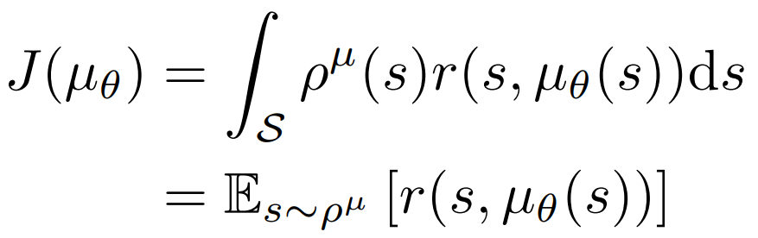
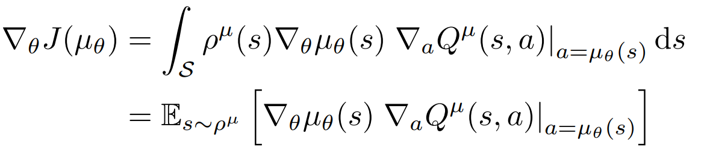
Deterministic Policy Gradient
Objective function:
Policy gradient:
Source: D. Silver, G. Lever, N. Heess, T. Degris, D. Wierstra, and M. Riedmiller. Deterministic policy gradient algorithms. Jan. 2014.

Slide 41
Outline
Outline
Teaser
Introduction/Motivation
Background
Solution
Implementation
Results
Future work and conclusions

Slide 42
RL Algorithms
Q-Learning
State-Action-Reward-State-Action (SARSA)
Deep Q-Network (DQN)
Stochastic Policy Gradients (PG)
Deterministic Policy Gradients (DPG)
Deep Deterministic Policy Gradients (DDPG)

Slide 43
Deep Deterministic Policy Gradient Method (DDPG)
Model-free, off-policy, actor-critic strategy derived by Lillicrap et al.
Based on the Silver et al.’s DPG algorithm combined with learnings from Mnih et al.’s work on the DQN algorithm.
Highly flexible algorithm for continuous control.
Notes:
In Lillicrap’s paper, DDPG surpassed DPG performance in over 25 OpenAI environments without any network or hyperparameter changes. In some cases, produced a policy surpassing a planning algorithm with full access to underlying physical models and derivatives.

Slide 44
DDPG Key Features
Actor and critic represented by ANNs
Experience replay
Target networks for actor and critic
Batch normalization
Exploration noise
Notes:
Actor and critic represented by ANNs, from DPG and DQN
Experience replay from DQN
Target networks for actor and critic from DQN. Four networks in total.
Batch normalization, allows hyperparameter generalization from Ioffe’s work
Exploration noise ensures sufficient exploration despite actor following policy

Slide 45
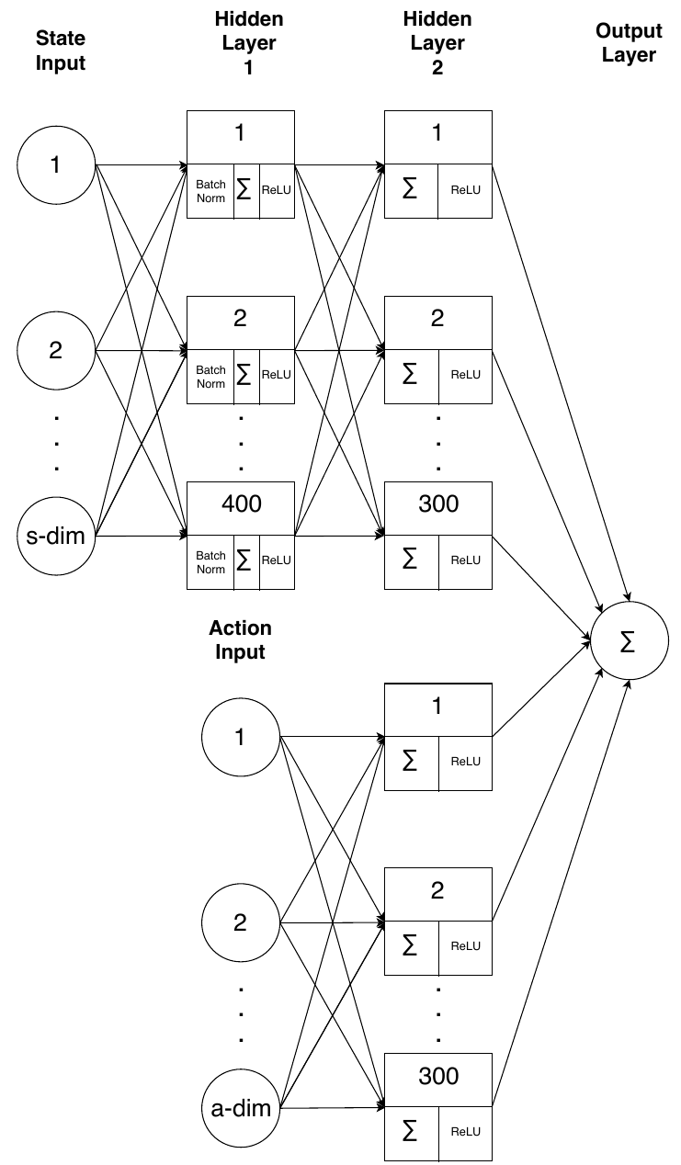
Critic Network Structure
s_dim-node state input layer
a_dim-node action input layer
Two fully connected hidden layers
HL1: 400 nodes
HL2: 600 nodes (300 for each half)
1-node output layer representing Q
Notes:
Batch normalization on state input. Rectified linear unit activation function

Slide 46
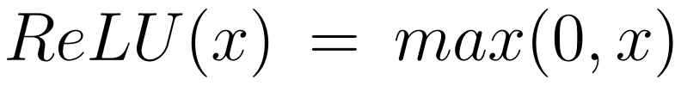
ReLU
Rectified Linear Unit activation function:
Derivative of ReLU:
1 for positive inputs
0 otherwise
Greatly speeds up forward and backward passes of network.

Slide 47
Critic Network Details
Adaptive moment estimation (Adam) optimizer:
Parameter updates invariant to gradient scaling.
Step size annealing.
Bounded step size.
Loss function (single step):

Slide 48
Critic Network Action Gradients
Gradient of the critic output with respect to each input action.
Used for weighting the actor output gradient.

Slide 49
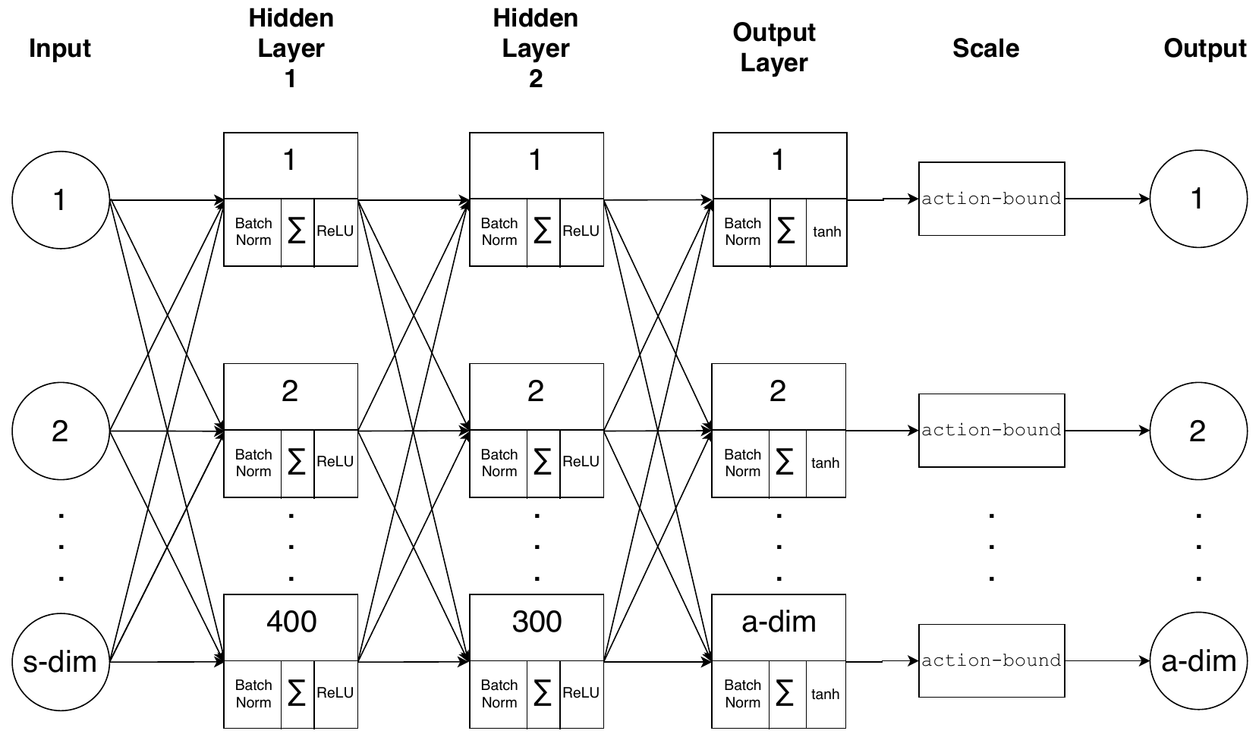
Actor Network Structure
s_dim-node input layer
Two fully connected hidden layers
HL1: 400 nodes
HL2: 300 nodes
a_dim-node output layer representing actions
Output scaling
Notes:
ReLU activations.
Tanh for output to bound. Multiply by scalar

Slide 50
Actor Network Details
Adam optimizer.
To update weights:
Calculate gradient of the network output with respect to network weights and biases
Weight by action gradients from the critic network.

Slide 51
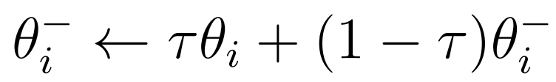
Target Networks
Duplicates of actor and critic networks.
Weights updated after each mini-batch using τ = 0.001:

Slide 52
Outline
Outline
Teaser
Introduction/Motivation
Background
Solution
Implementation
Results
Future work and conclusions

Slide 53
Implementation
Python 3.6
TensorFlow for ANNs
OpenAI Gym
Pyglet

Slide 54
Classes
ActorNetwork
CriticNetwork
Robot
RobotSim
DDPG
OrnsteinUhlenbeckActionNoise

Slide 55
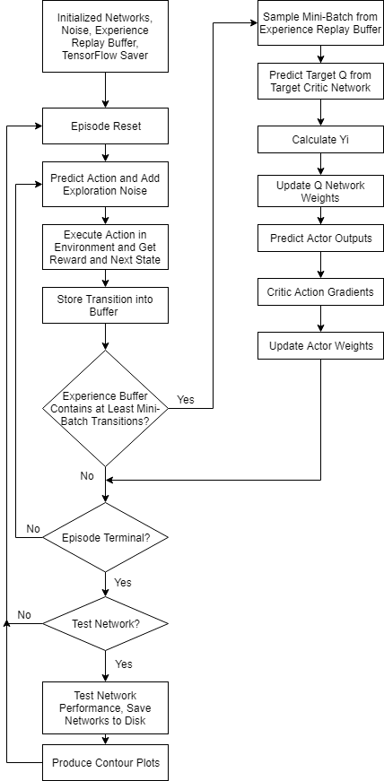
DDPG Flowchart

Slide 56
Simulation
Simulates robot in the environment.
Models individual motor motion (acceleration, maximum speed, momentum).
Does not model:
Friction with ground
Varied loading on each wheel
Whole robot momentum
Small differences between motors and wheels

Slide 57
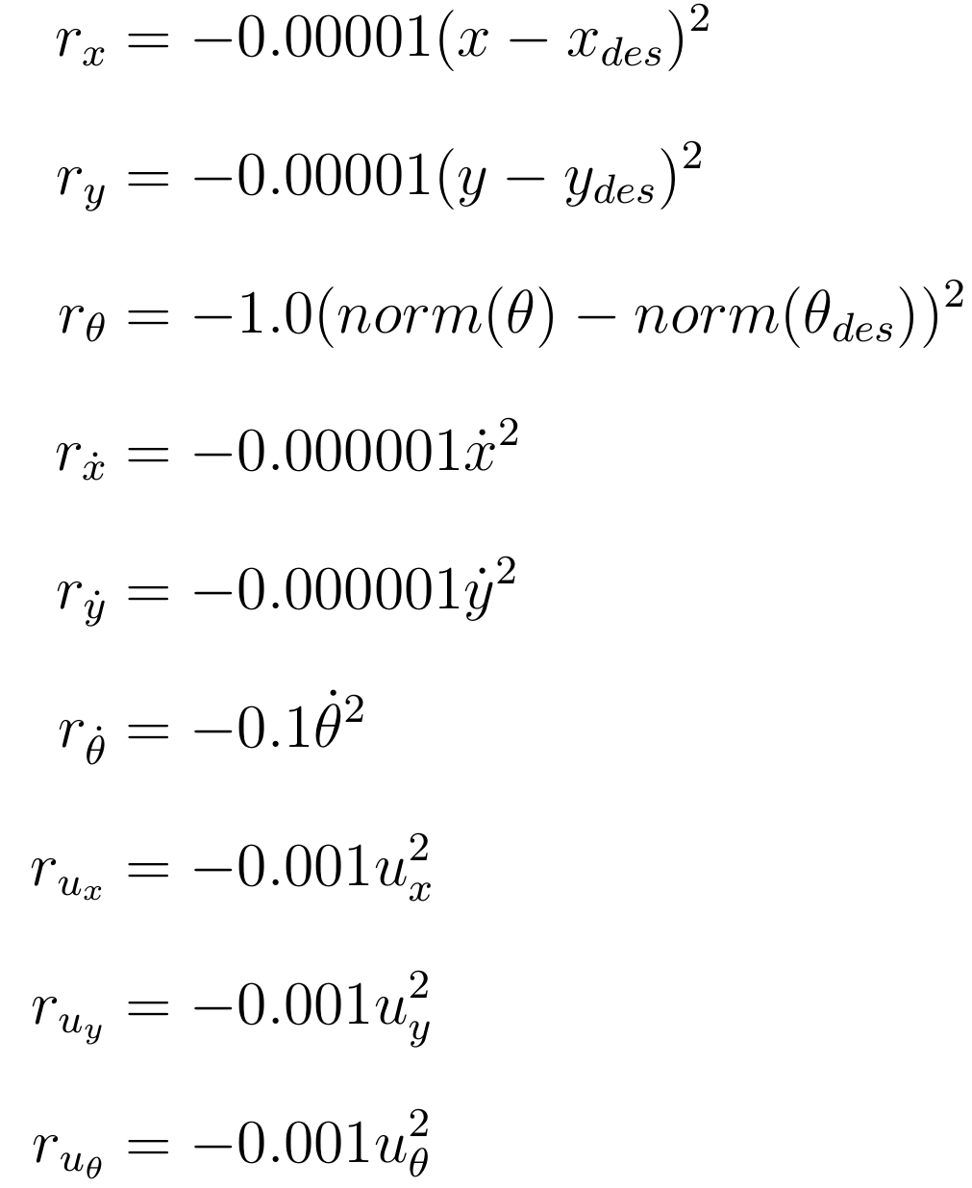
Reward Assignment
Maximum reward is 0.
Becomes more negative with:
Increased error from set point.
Larger magnitude velocity.
Larger magnitude actions.

Slide 58
Three Actors Variant
Three separate DDPG networks for each orthogonal direction:
X translation network
Y translation network
Rotation network
Only two state inputs each:
Position (x, y, θ)
Velocity (dx/dt, dy/dt, dθ/dt)
Notes:
Robot can move omnidirectionally.

Slide 59
Three Actor Variant Training Parameters
Episode length: 10 seconds
Episode step period: 0.05 seconds
Actor learning rate α_{actor}: 0.0001
Critic learning rate α_{critic}: 0.001
Discount factor γ: 0.99
Target network update parameter τ: 0.001
Mini-batch size: 64

Slide 60
Single Actor Variant
One DDPG Network with three outputs for x, y, θ actions.
Uses the same inputs as the three actor variant together.
Reduced learning rate to avoid learning instability.

Slide 61
Single Actor Variant Training Parameters
Episode length: 10 seconds
Episode step period: 0.05 seconds
Actor learning rate α_{actor}: 0.00001
Critic learning rate α_{critic}: 0.0001
Discount factor γ: 0.99
Target network update parameter τ: 0.0001
Mini-batch size: 128

Slide 62
Outline
Outline
Teaser
Introduction/Motivation
Background
Solution
Implementation
Results
Future work and conclusions

Slide 63
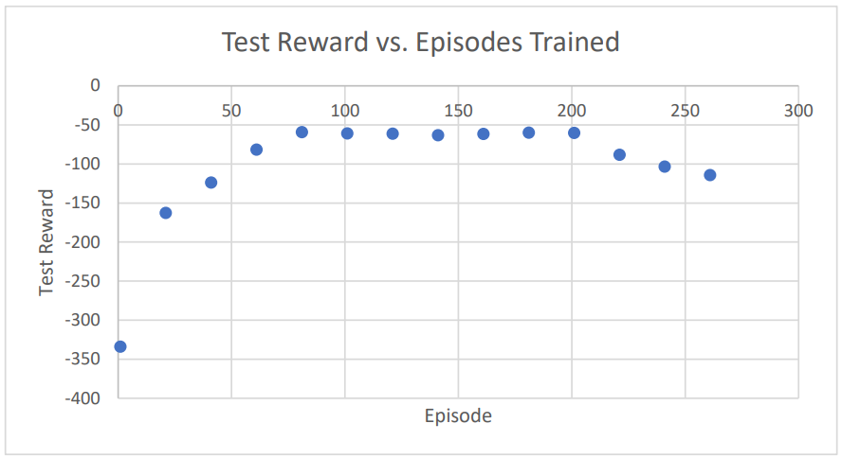
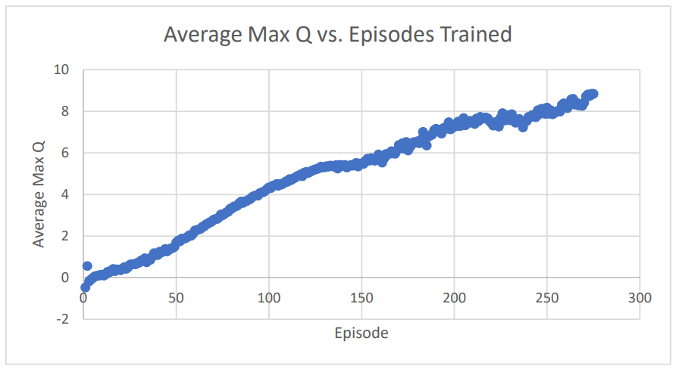
X Translation Results

Slide 64
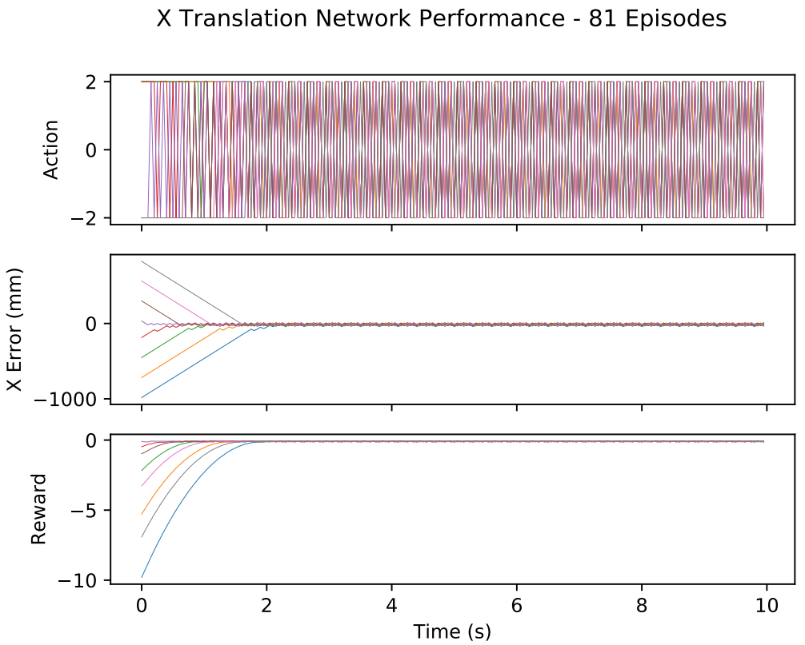
X Translation Response
Robot reaches set point.
No overshoot.
Oscillatory action behavior.

Slide 65
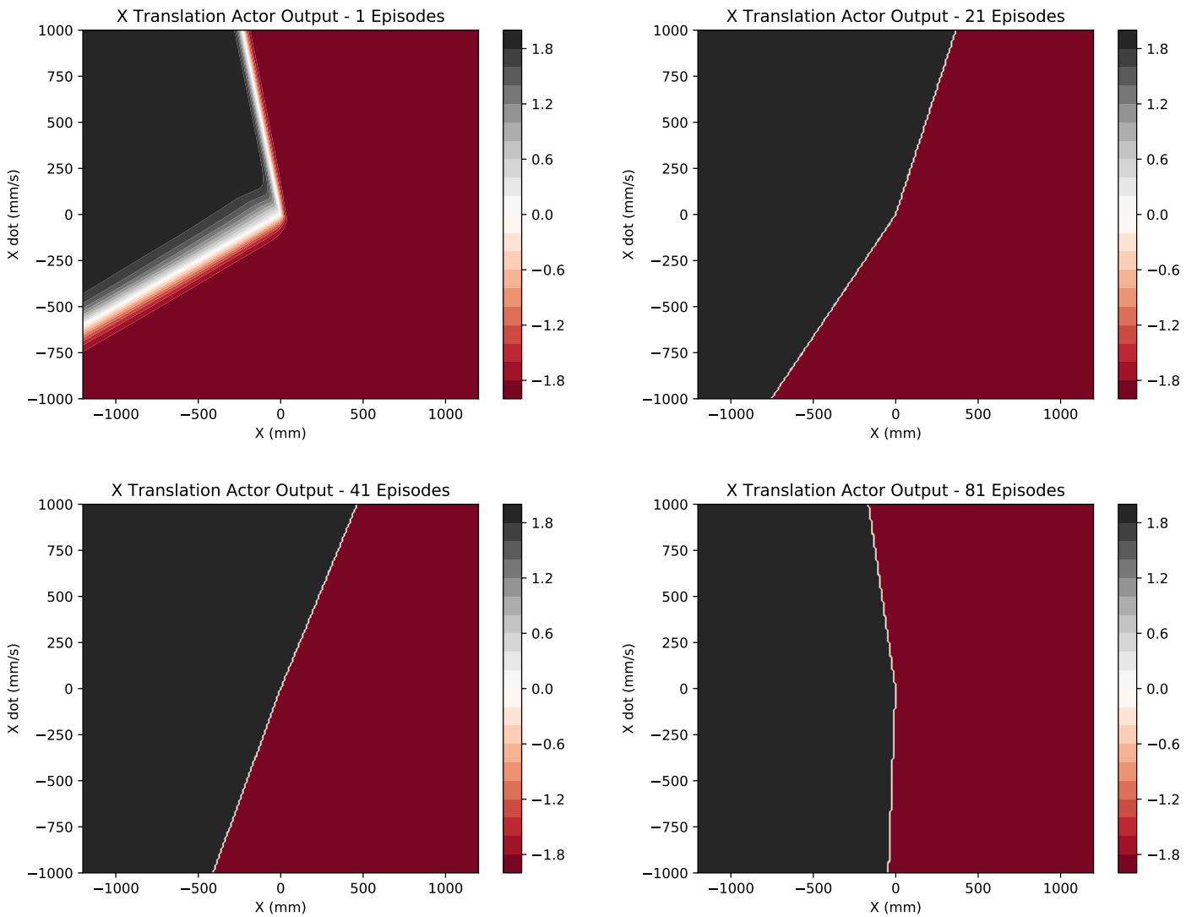
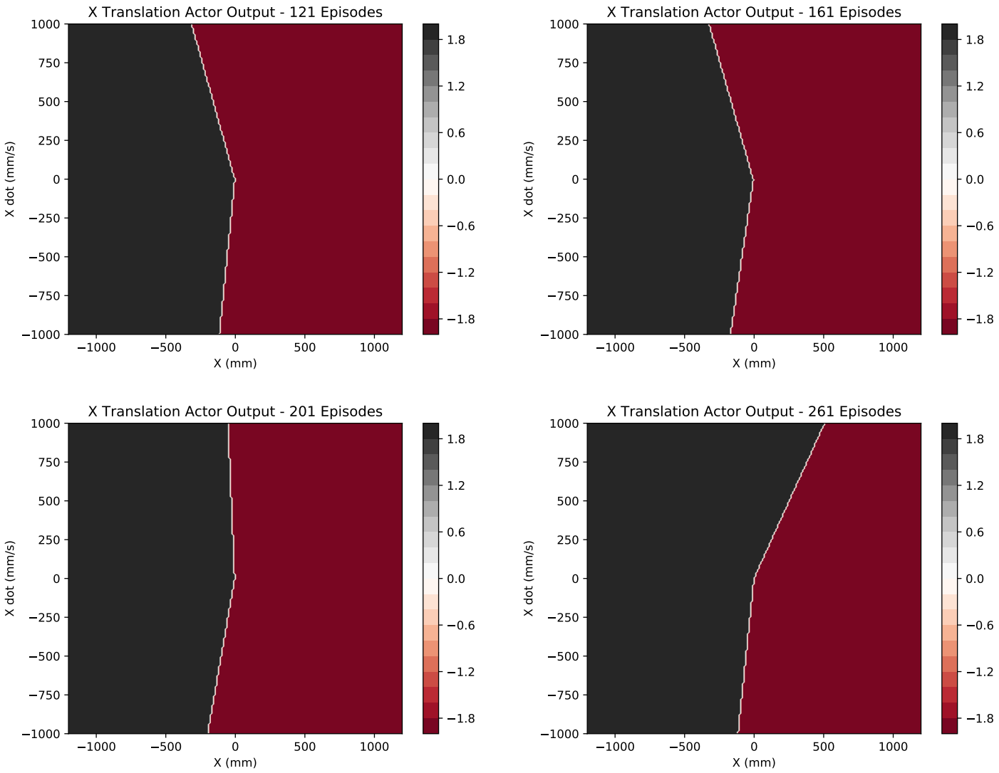
X Translation Actor Progress

Slide 66
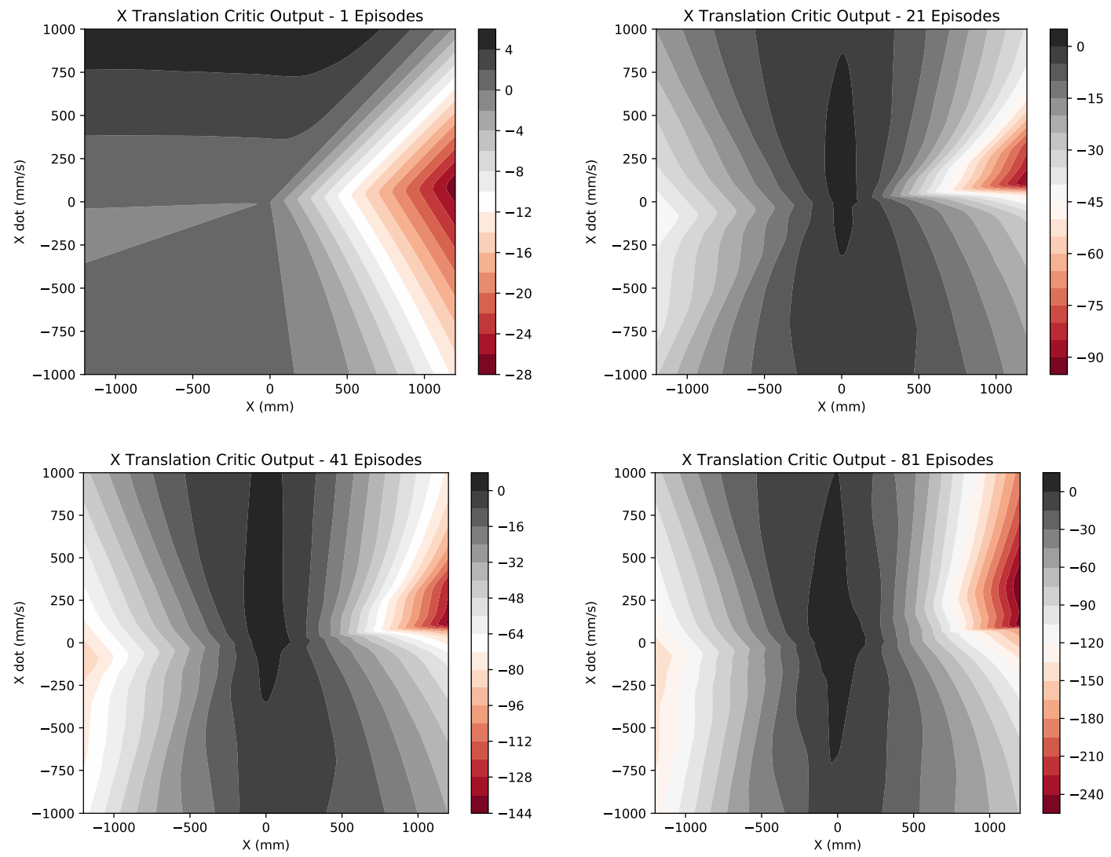
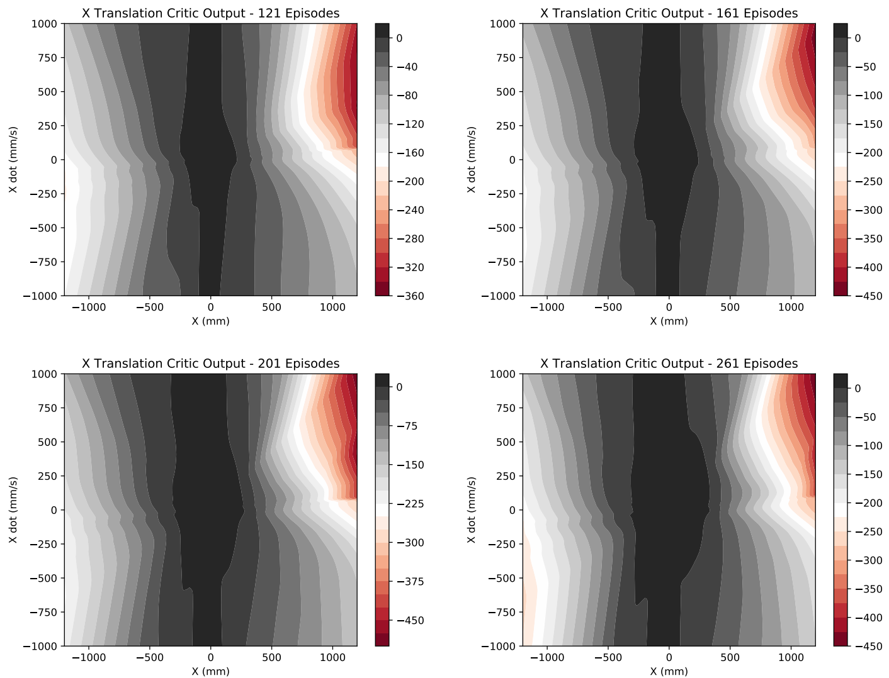
X Translation Critic Progress

Slide 67
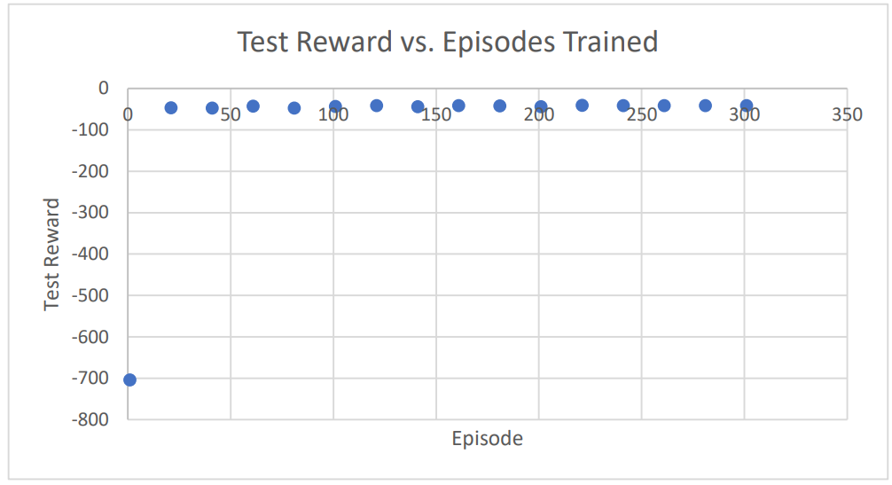
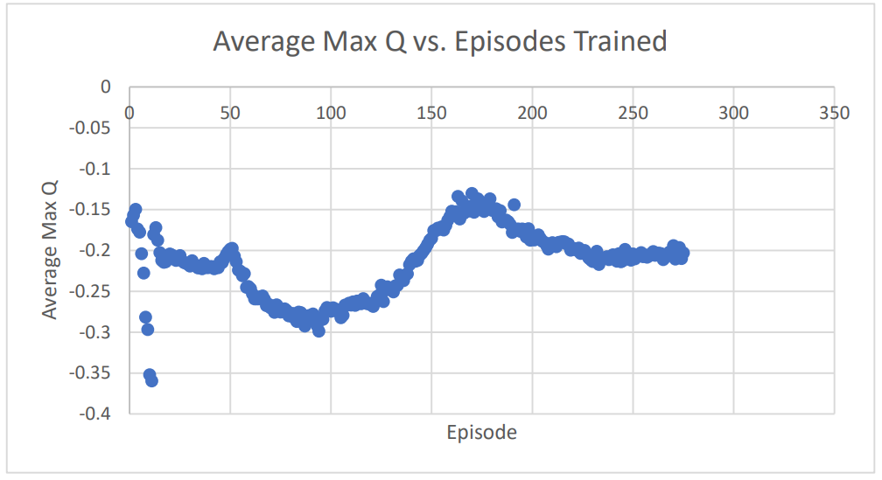
Rotation Network Results

Slide 68
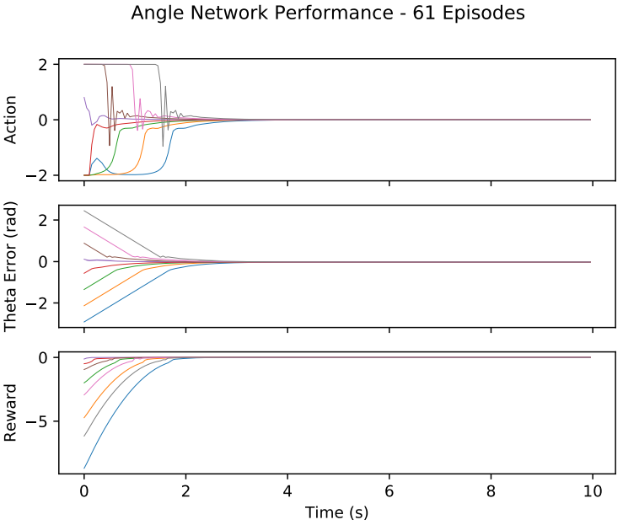
Rotation Network Response
Action decays to 0.
No overshoot.

Slide 69
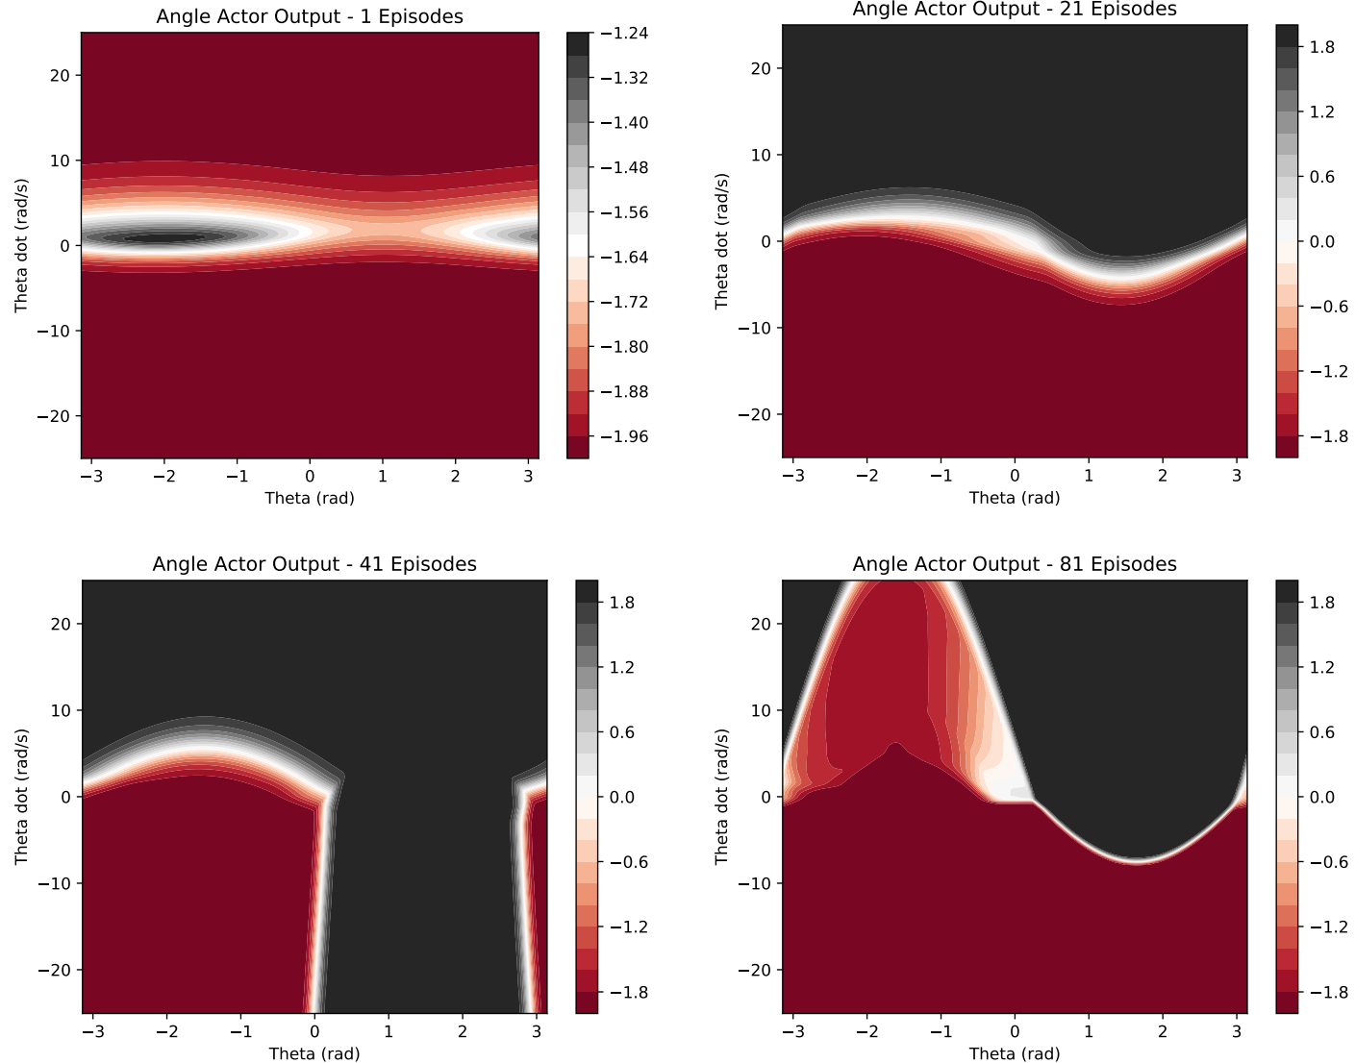
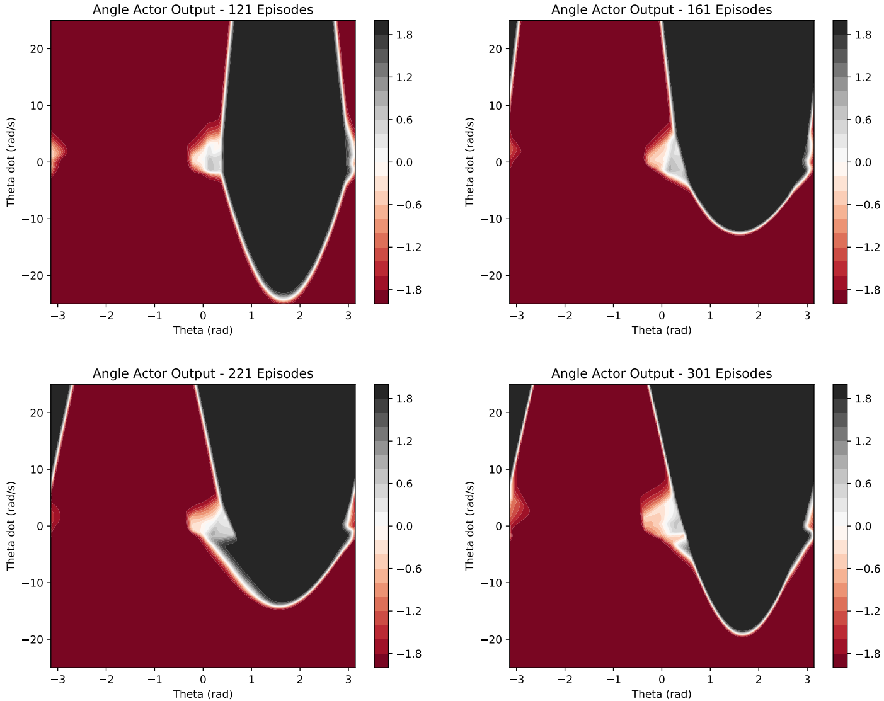
Rotation Actor Progress

Slide 70
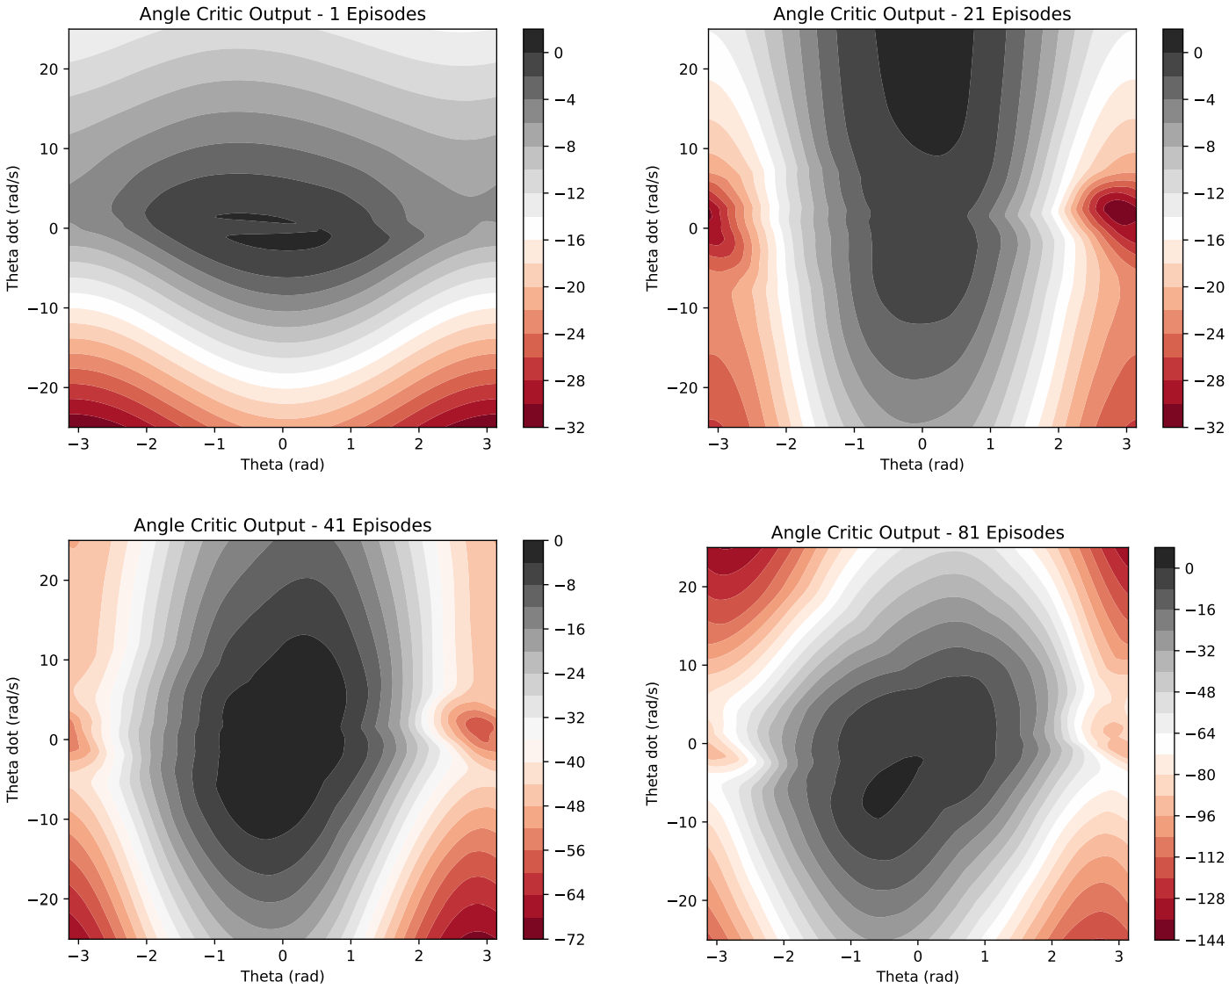
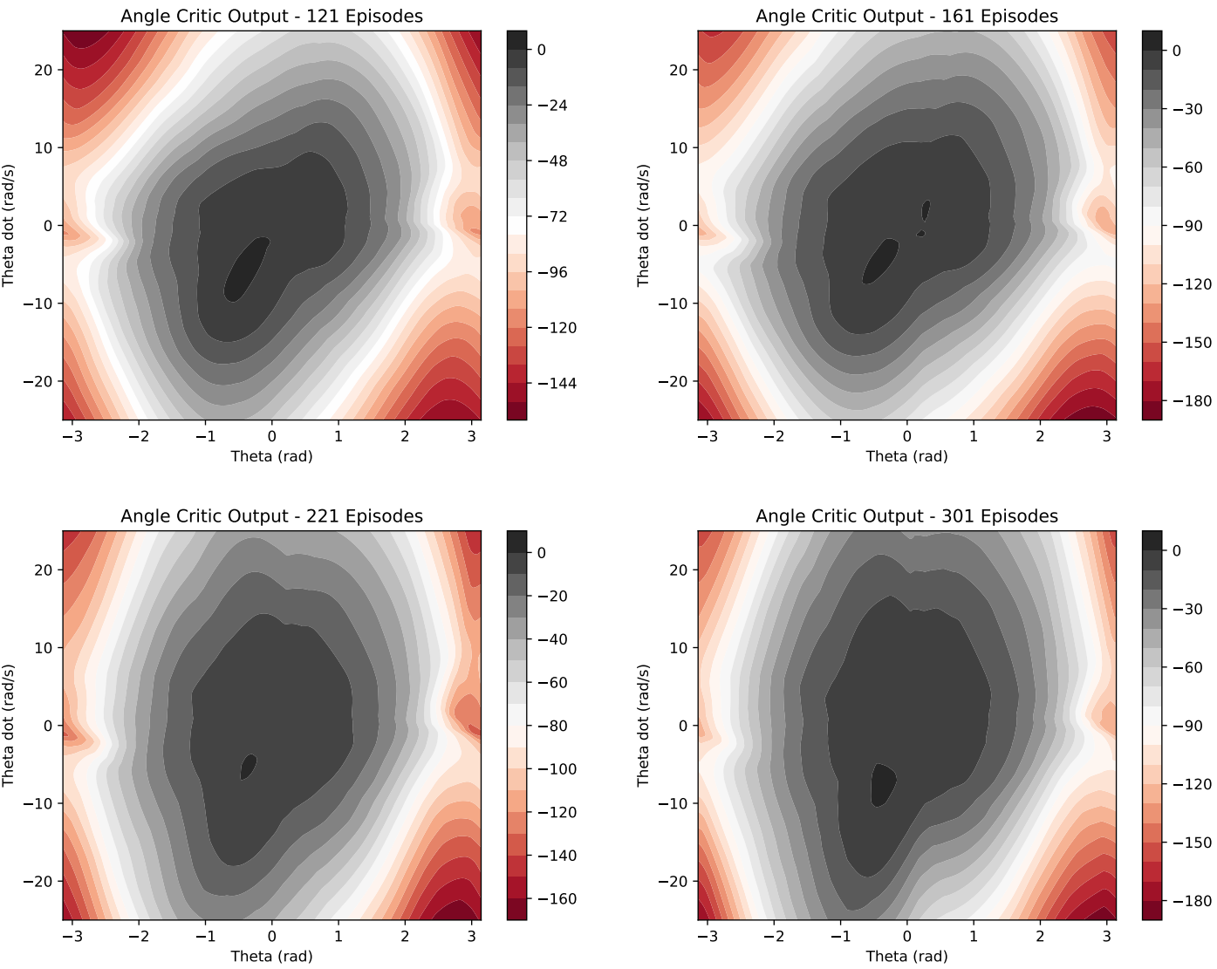
Rotation Critic Progress

Slide 71
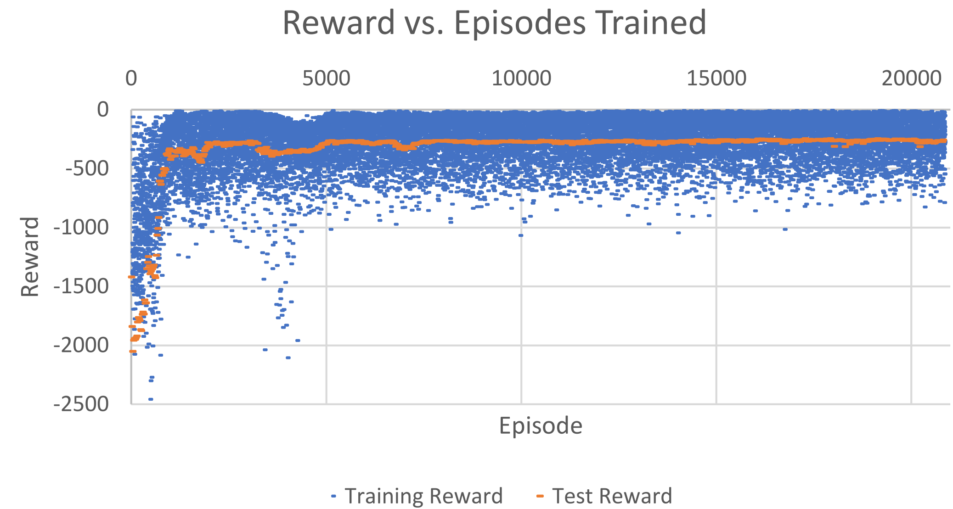
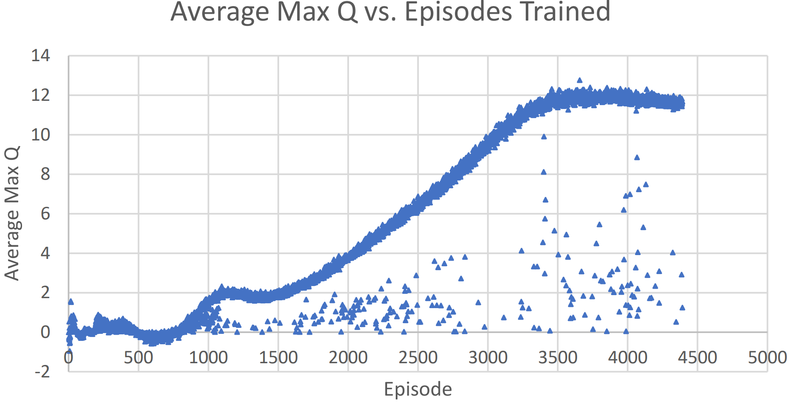
Full Control Network Results

Slide 72
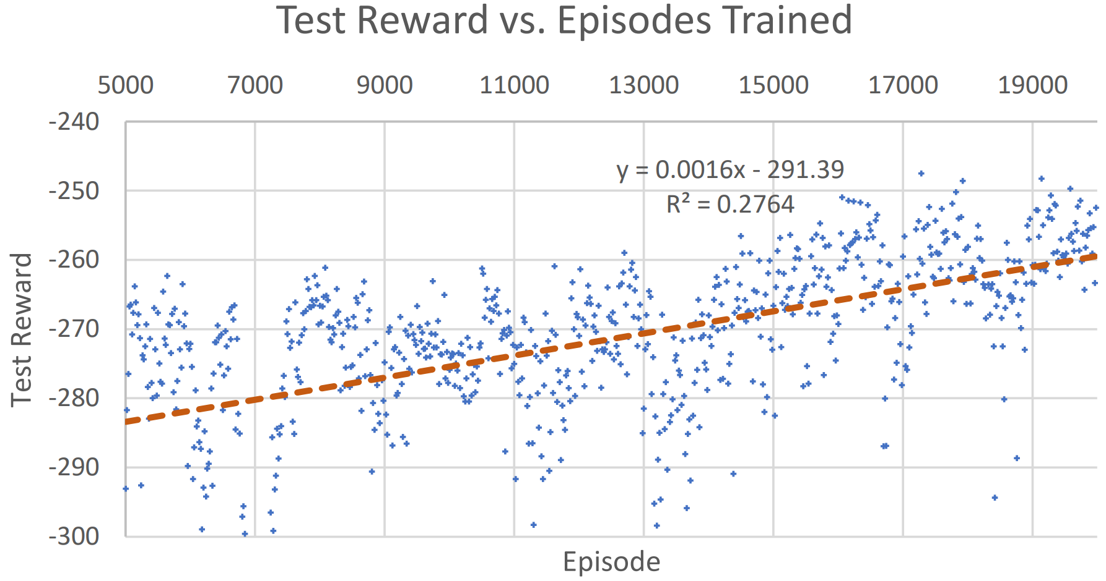
Full Control Network Test Reward Close-Up

Slide 73
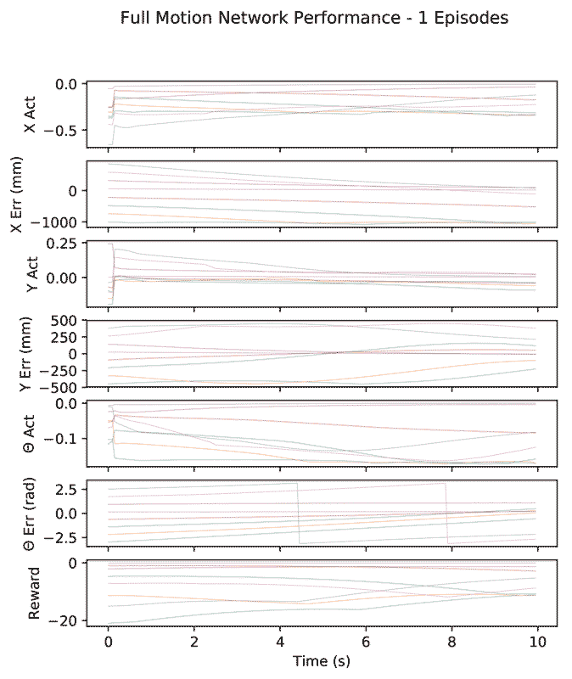
Full Control Network Response
Reaches -276.5 reward by episode 5,041.
Maximum reward of -247.5 at episode 17,281.
Notes:
Progress from 1 to 21,201 episodes.

Slide 74
Outline
Outline
Teaser
Introduction/Motivation
Background
Solution
Implementation
Results
Future work and conclusions

Slide 75
Conclusion
DDPG effectively solves continuous control of the robot.
Where possible, dividing the system by orthogonal controls allows focused training.
Reliant on reward assignment to achieve desired result.
Notes:
Where possible, dividing the system by orthogonal controls allows focused training:
Improves convergence.
Reduces training time.
Can retrain individual networks without affecting others.
Small changes in reward assignment weights changed training outcome.

Slide 76
Future Work
More experimentation with reward assignments.
Algorithm for automatic reward scaling.
Additional model parameters.
More training with robot instead of simulation.

